Slide 1
Run legacy middleware, migrate workloads
Rick Osowski osowski@us.ibm.com
Jen Ricciuti jricciut@us.ibm.com

Slide 2
What are the benefits to the customer on migrating their applications to the IBM Cloud?
Use Cases driving Private Cloud Adoption
1. Optimize legacy apps with cloud
2. Open your datacenter to work with cloud services
3. Create new cloud native applications
Public Cloud Services
Self-service Experience
APIs
New Applications
Next Generation Middleware, Data & Analytics
Integration Services & Cloud Native Programming Models
Cloud Native Services & Runtimes
Machine Learning on p/z
Automation & Orchestration
Automation & Orchestration
Blockchain
Automation & Orchestration
Business Process
Private Cloud Platform
Containers & VMs
Common Services
Private Cloud Platform
Containers & VMs
Common Services
Private Cloud Platform
Containers & VMs
Common Services
Data & Apps
On-Premises Software & Services
Cloud-enabled middleware
Integration & Hybrid Cloud
New
Applications
Manage multi-cloud with ease; Infuse multi-cloud apps with intelligence

Slide 3




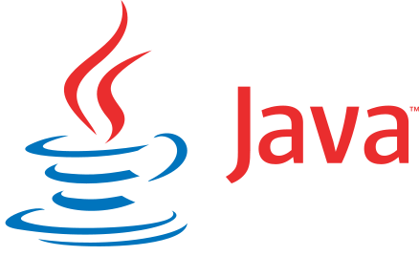
Purple compute: An evolution to microservices
Significant investment in WebSphere portfolio
Existing deployment practices holding back business
Incremental migration of business logic and services
Modernize application stack, focusing on core runtime capabilities (REST, CDI, and more)
Phase 0
Phase 1*
Phase 2*
Phase 3
Phase 4
WAS 7
Current State
WAS 8.5
Modernization
Mitigation Phase
Production Lift & Shift
Evolve to Microservices
https://www.ibm.com/blogs/bluemix/2017/06/taking-websphere-applications-to-the-cloud/

Slide 4
Phase 1: Modernizing the existing application
Initial need to migrate to current runtimes, projects, and supporting libraries on WebSphere V9
It is an intermediate modernization step and not a complete rearchitecture
This phase focuses on modernizing application components to present-day versions, as well as development environments and delivery pipelines to modern practices
https://www.ibm.com/blogs/bluemix/2017/08/websphere-on-the-cloud-application-modernization/
https://github.com/ibm-cloud-architecture/refarch-jee/blob/master/phases/phase1.md

Slide 5
Phase 2: Mitigation
This phase focuses on moving core pieces of compute-based business logic to cloud-based services
You are entering into a hybrid cloud scenario
Networking and security practices are defined during this phase
Most existing database and messaging capabilities are left in-tact during this phase
The focus is on the core compute functionality in the new cloud environment
https://www.ibm.com/blogs/bluemix/2017/09/websphere-on-the-cloud-application-mitigation/
https://github.com/ibm-cloud-architecture/refarch-jee/blob/master/phases/phase2.md

Slide 6
Phase 3: Production lift and shift
The lifted application and all core critical components are moved to the cloud provider
Additional components may still exist on-premises, and depending on latency requirements, either directly connected to the cloud provider or cached via secured, higher-latency direct connections to the on-premises resources
Adoption of newer cloud-based services are often adopted during this phase
For example, newer databases and messaging capabilities
https://www.ibm.com/devops/method/tutorials/was_lift_shift

Slide 7
Phase 4: Evolve to microservices
This phase focuses on breaking the monolithic application into microservices
Hosting them on Kubernetes on IBM Bluemix
Move to microservices on a per-business capability basis, depending on prioritized pain-points the existing lifted monolith is still presenting
Done repeatedly until the application teams can move at the speed the business requires
The most practical pattern for this approach is the Strangler Pattern
It sections off business capability to be reimplemented in a new microservice while the rest of the existing application functions as-is
https://www.ibm.com/blogs/bluemix/2017/09/websphere-on-the-cloud-evolving-to-microservices/
https://github.com/ibm-cloud-architecture/refarch-jee-monolith-to-microservices

Slide 8
Migration: Why and how do I migrate?

Slide 9
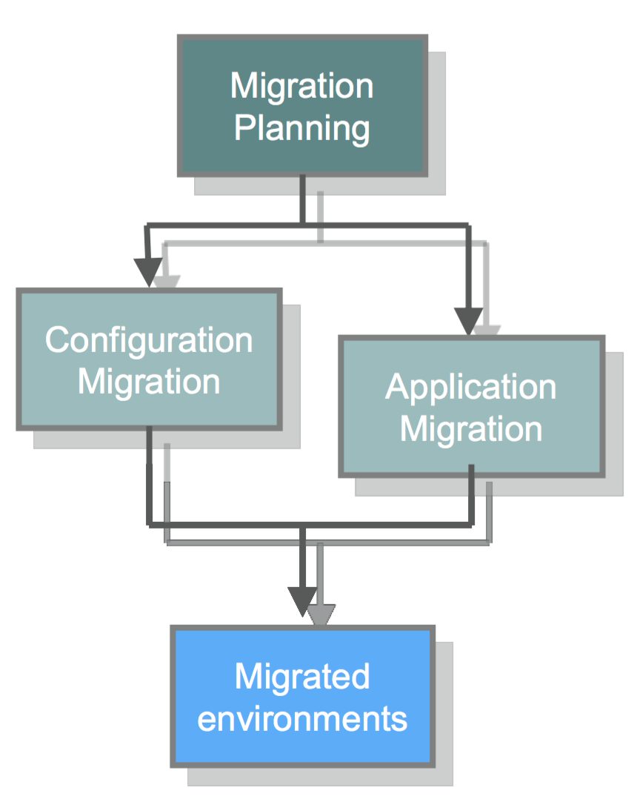
Migration planning
Migration planning analyzes the application from multiple viewpoints and produces a project plan
Such as source code, runtime, and more
The migration process involves a variety of steps
Application changes and testing
Migrating configurations
Performance testing
Whether you are moving your workloads to a later release on-premises or exploring cloud platforms, tools are available to help
Notes:
Migration planning analyzes the application from multiple viewpoints (e.g. source code, runtime, etc.) and produces a project plan; Includes Migration Discovery and Assessment
Configuration migration defines the topology for all of the runtime environments (e.g. integration, QA, etc.) and installs and configures them
Source migration extracts and transforms vendor specific details from application source code and J2EE server configuration until they are compatible with the target version of WebSphere
Testing prepares and executes functional and non-functional tests
The result is a fully migrated application running in a WAS 9.0 production environment with equal or greater performance and scalability.

Slide 10
Migration considerations
Migration impact is gated by two overarching factors
The WebSphere versions involved in the migration scenario
The amount of change introduced between these versions
Which version of WebSphere should I migrate to?
Do not only consider the best version, consider the best platform to migrate to
traditional WebSphere V9 for JEE 7
WebSphere Liberty
On-premises or cloud

Slide 11
Things to keep in mind about migrating
It is necessary to migrate both the runtime configuration and the application code
Migration tools can provide guidance and accelerate the migration process
All migrations are different; not one migration process will work for all environments
Do not change too much at one time
Consider migrating traditional WebSphere to WebSphere Liberty before moving to the cloud
Many changes occur naturally with the migration process
JDK might have to be upgraded
Version of specifications might change
Notes:
https://www.ibm.com/developerworks/library/mw-1701-was-migration/index.html/#WebSpheremigration

Slide 12
What do we advise on migrating?
Are you happy using traditional WebSphere?
Stay there, you do not have to move off traditional WebSphere
Are you using open source servers for development?
Switch to WebSphere Liberty for higher efficiency and easier deployment
Are you planning a new application / deployment?
Consider WebSphere Liberty for a flexible technology
Are you thinking of moving to the cloud?
IaaS: both traditional WebSphere and Liberty perform well
PaaS: WebSphere Liberty is the runtime of choice
Do you have a mixed application server environment?
Use hybrid management for a single point of control
Notes:
Have a mixed app server environment (WebSphere plus Tomcat, JBoss, and more)?
•Simplify to traditional WebSphere and WebSphere Liberty profiles
•Easy to move applications between servers as needs change
•Use cells for traditional WebSphere and lightweight collectives for WebSphere Liberty
•Use hybrid management for a single point of control

Slide 13
Why should I migrate to traditional WebSphere V9?
Includes the latest Java standards, capabilities, and performance benefits
Intelligent management
API Lifecycle management
It is the easiest migration path
Move to a recent version and stay in your data center
WebSphere V9 is Cloud ready
Take advantage of the WebSphere Java runtime on IBM Bluemix, or a mix of hybrid cloud environments using instant runtimes, Docker images, or virtual machines
WebSphere V7 and V8 along with the underlying Java 6 are going End Of Service in April 2018
Integration with cloud services
Lightweight microservice deployment
Notes:
WebSphere V9 brings traditional WebSphere deployments up to the same level of EE7 and Java 8 as WebSphere Liberty.

Slide 14

Why should I migrate to WebSphere Liberty?
For rapid development and light-weight production deployment with high scalability
Certified to full Java EE7
Small footprint (64MB), quick startup (< 3 sec)
Developer-first design of simple, shareable XML configuration
Dynamic runtime and configuration
Unzip install and deploy on premises or run on cloud
Provides the Java application runtime in IBM Bluemix
Monitoring and management through Admin Center or scripting
Install new features from repository with no server restart
Lightweight collective management scales to 10,000 servers

Slide 15
Considerations when moving from tWAS to Liberty
There are considerations when moving an application from traditional WebSphere to WebSphere Liberty
WebSphere Liberty server supports a subset of the programming models provided by traditional WebSphere
Administration model is different (cell vs collective, managed configuration files vs editable server.xml, and more)
WebSphere provides different methods of controlling class visibility than traditional WebSphere

Slide 16
How do I refactor to microservices?
Step 1: Repackage the application
Split up the EARs into independent WARs
Apply the "Container per service" pattern and deploy each WAR in its own Liberty server, preferably in its own container then scale containers independently
Build, deploy, and manage independently
Step 2: Refactor the code
Start looking for opportunities to refactor the WARs to even more granular levels
Step 3: Refactor the data
Refactor the data structures that your applications are built on
Hardest problem in adopting microservices
Notes:
Refactoring to microservices would thus mean adding microservices into your application without necessarily changing what it does.
Martin Fowler introduced the term strangler application in his seminal article Strangler Application in 2004. In this pattern, a new system captures and intercepts calls to mature applications, routes them to other handlers, and gradually replaces them altogether. Rewriting the whole existing system from the first step is risky; the strangler application method reduces risks more than the cut-over rewrite approach. In moving from monolithic to microservices architecture, you can incrementally refactor your monolithic application. You gradually build a new application that consists of microservices; you then run this application together with the monolithic application. Over time, the amount of functionality handled by the monolithic application is incrementally decreased until either it disappears entirely or becomes part of the new microservices.

Slide 17
Migration and modernization tools

Slide 18
Migration steps
WebSphere Migration Toolkits provide assistance in full cycle of on-premise or in cloud migration
Step 1. Migration Discovery
Step 2. Migration Assessment
Step 3. Source Migration
Step 4. Configuration Migration
Goal:
Understand suitability and options for cloud.
Choose the target WAS server or cloud platform
Output:
Decision on migration to on-prem or cloud, rough effort estimate
Goal:
Analyze source code for challenges in migrating the application to target WAS server or cloud platform
Output:
Report on migration challenges and fine tuning of the effort estimate
Goal:
Make the changes to the application’s source code
Output:
Migrated application that has passed the developer tests.
Goal:
Make the changes to the application configuration across all stages on-prem on in cloud
Output:
Successfully transform on-prem application to selected WAS or cloud platform
Understand
Notes:
Perform detailed workload analysis

Slide 19
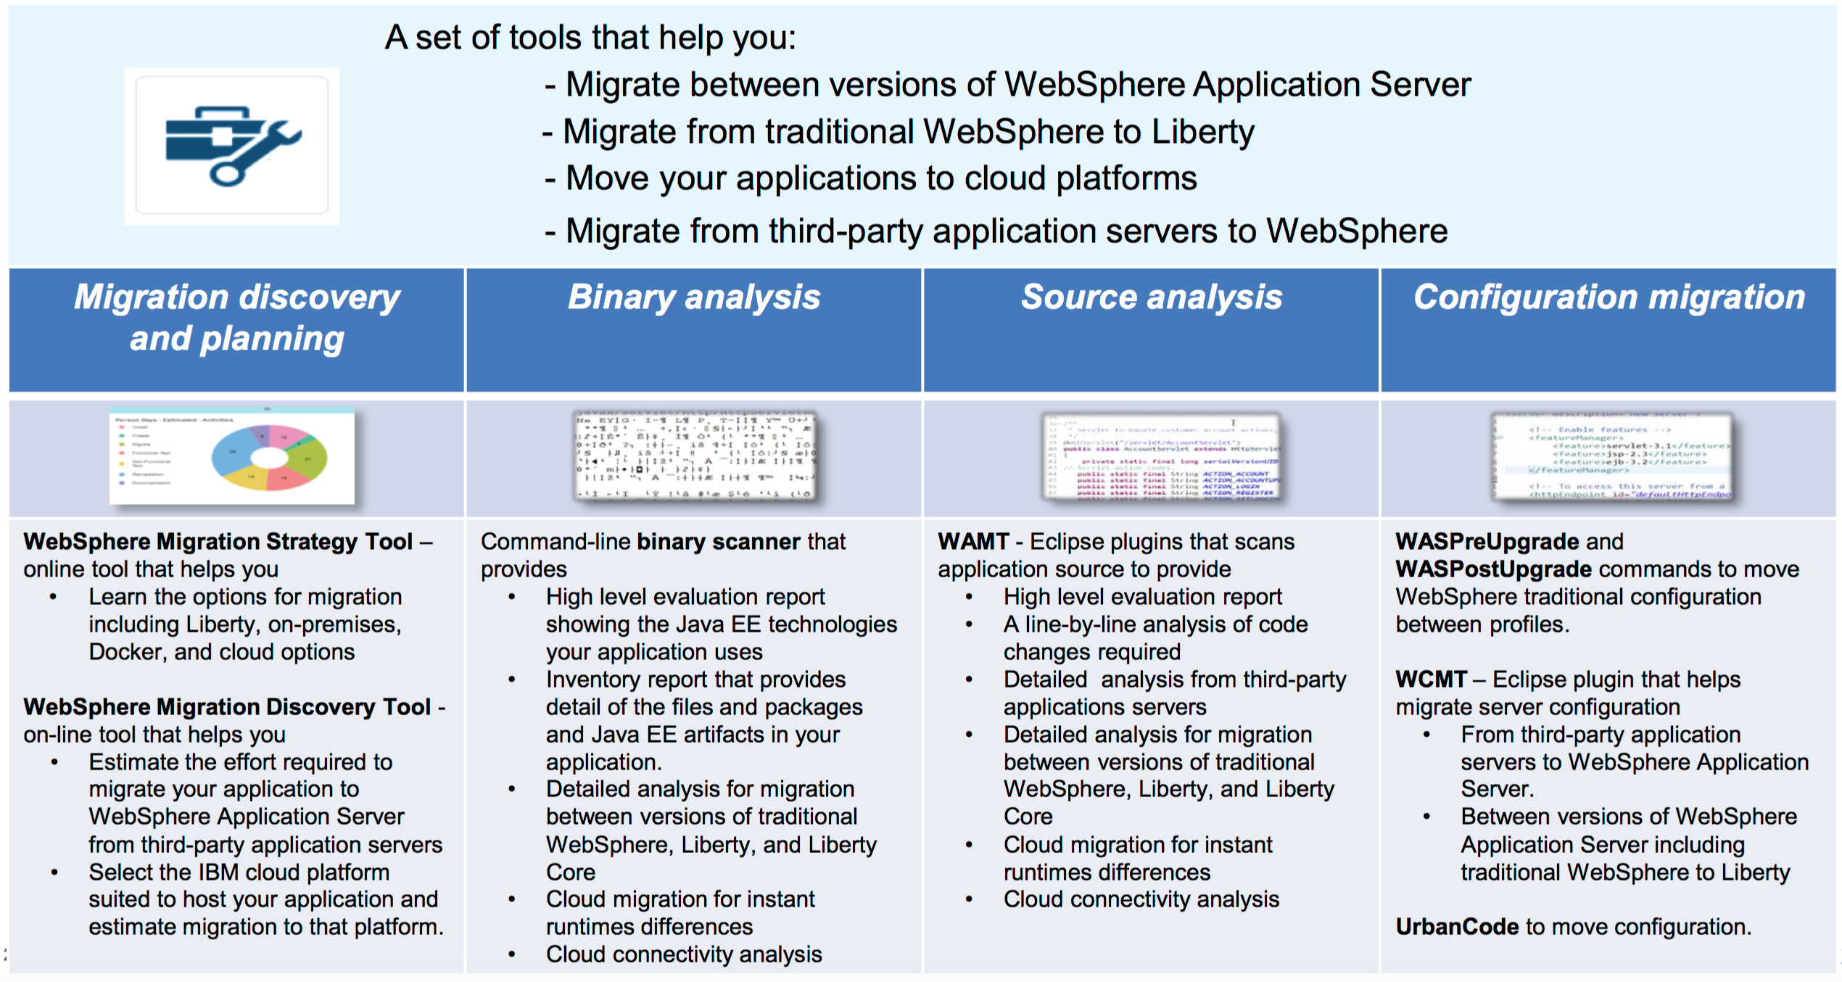
Overview of WebSphere migration tools
Notes:
Migration toolkits include these products:
WebSphere Application Server Application Migration Toolkit (WAMT)
Migration Toolkit for Application Binaries
WebSphere Configuration Migration Toolkit (WCMT)
WebSphere Application Server Migration Discovery Tool

Slide 20

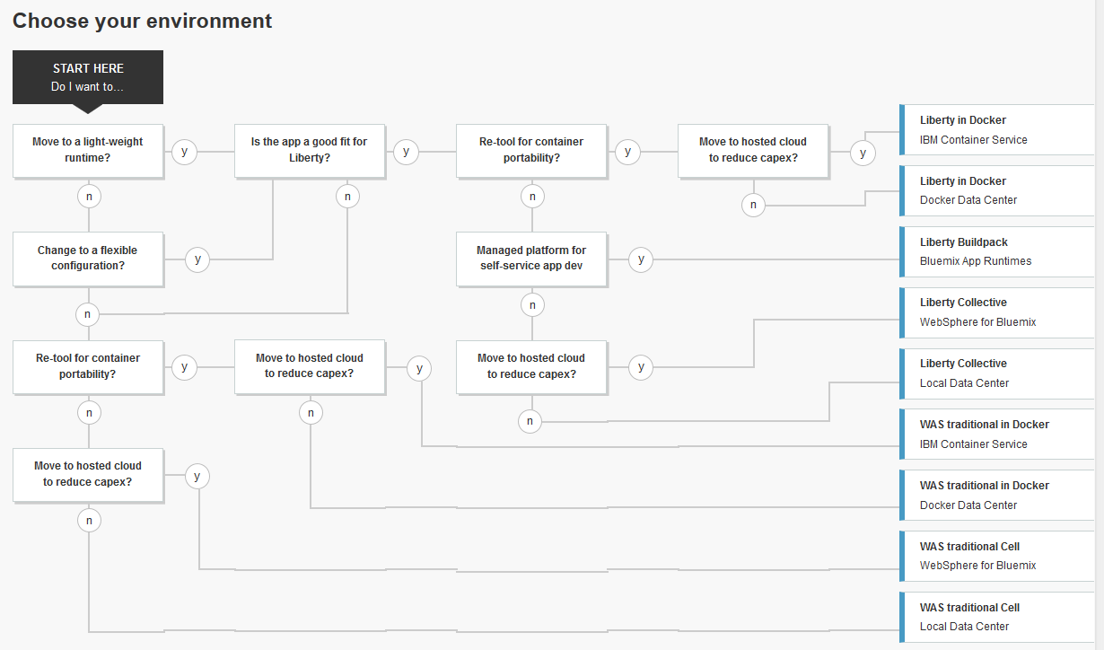
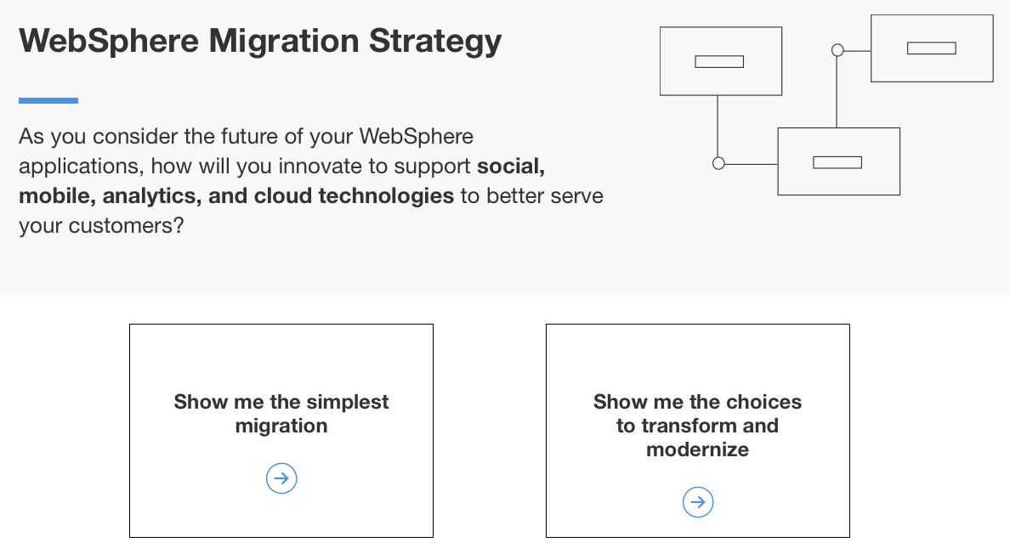
WebSphere Migration Strategy Tool
http://whichwas.mybluemix.net
Notes:
Use the migration strategy tool to learn about your choices to transform and modernize your WebSphere applications.

Slide 21
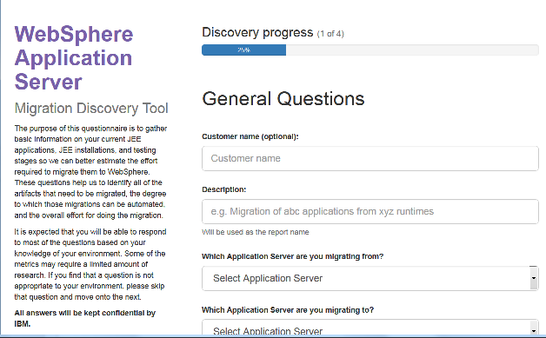
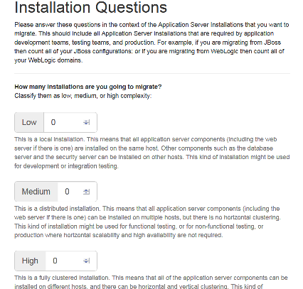
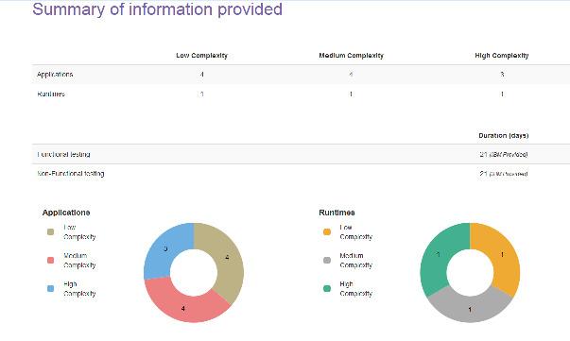
WebSphere Migration Discovery Tool
Online anonymous tool to help estimate effort required for migrating Java EE applications
Helps identify all assets that need to be migrated
Provides high-level estimate on the overall migration effort
Can be used for migrations to
traditional WebSphere
WebSphere Liberty
WebSphere Liberty on IBM Bluemix
http://ibm.biz/MigrationDiscovery
Notes:
This tool gives you a high-level idea of the migration effort that is involved if you are considering migrating applications from these products:
Previous version of WebSphere Application Server
Competitive application servers:
Apache Tomcat Server
JBoss Application Server
Oracle Application Server
Oracle WebLogic Server
The estimate is based on experience and IBM historical data. It provides initial insights into the size and scope of the migration. The margin of error for this estimate is within a rough order of magnitude. It is ideal for budget assumptions and planning. IBM migration experts can also provide a no cost migration assessment to confirm that actual work effort and costs, if you want.
The tool consists of only four screens that you need to complete to get an estimate:
General questions
Application questions
Installation questions
Testing questions
You can answer all of these questions in a matter of minutes.

Slide 22
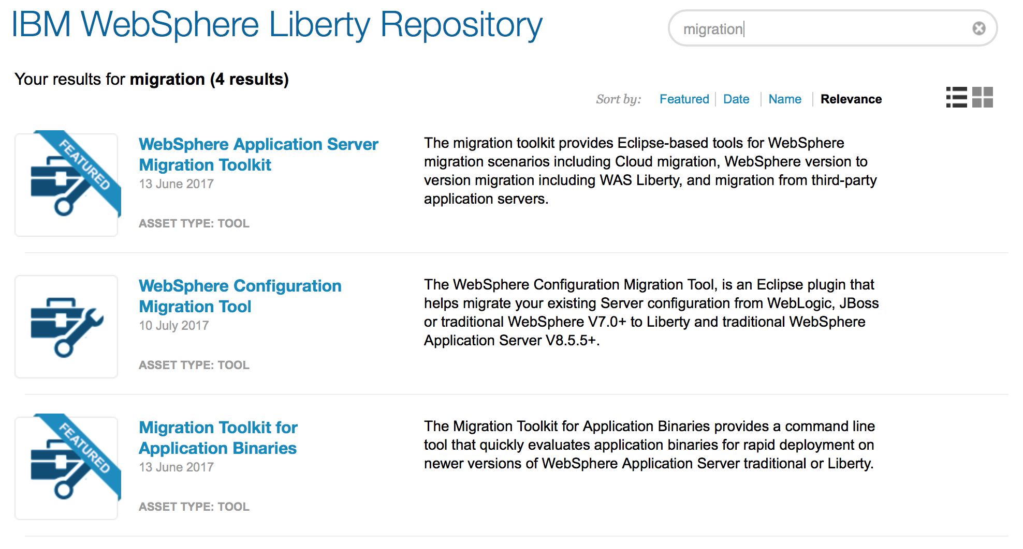
Where do I get the other migration tools?
http://wasdev.net – go to the Download tab and filter on “migration”

Slide 23

How do I use the Binary Scanner?
Migration Toolkit for Application Binaries (binary scanner)
The binary scanner evaluates the application binaries
EAR, WAR, JAR, class files, and more
Provides command line convenience
No import to Eclipse is required
Runs from a script
JSON, text or HTML output
Detailed analysis for migration to WebSphere Liberty and IBM Bluemix
Notes:
The Migration toolkit for application binaries is a command-line tool that scans your application binaries without source code. You can use it with application migrations between versions of WebSphere Application Server traditional (Version 7 and later), from WebSphere Application Server traditional to Liberty, and to Liberty PaaS environments such as Liberty for Java on IBM Bluemix.
It requires the installed command-line tool and your application archives, such as EAR, JAR, WAR, or class files. It shows which editions of WebSphere Application Server are best suited to run the application.
The toolkit also provides an inventory of Java EE programming models that are used by the application, and it indicates whether the application is supported by WebSphere Application Server traditional or Liberty.

Slide 24


Analyzing application binaries
WebSphere Liberty
Migration Toolkit for Application Binaries
WebSphere Liberty
traditional WebSphere Application Server
V7.0
traditional WebSphere Application Server
Java EE 5 or 6
Java SE 5, 6 or 7
Java EE 6 or 7
Java SE 7 or 8
On premises, instant runtime, WAS on Cloud, Docker
Notes:
The binary scanner can be used for WebSphere Application Server traditional version to version migration, WAS traditional to Liberty, and Liberty to Liberty migration such as scanning for Java EE 7 differences.
The tool includes the ability to generate a Detailed Migration Analysis Report, highlighting any Java EE programming model and WebSphere API differences between WebSphere Application Server traditional and Liberty. The tool offers advice and potential solutions to assess the ease of moving applications to Liberty. It also informs you of any Java EE specification implementation differences that might affect your applications.
The tool also includes scanning capability to quickly evaluate application binaries for rapid deployment on Liberty. The tool generates a visual report that identifies the Java EE programming models in the application and provides a recommendation for the right-fit IBM WebSphere Application Server edition.
Because this command-line tool does not require Eclipse, it is appropriate for both administrators and developers who use other IDEs. It is also great for evaluating applications whose source code is misplaced or lost.
The tool is an executable JAR file with one required parameter, the binaryInputPath, which is an absolute or relative path to a binary file or directory that contains binary files. If you specify a directory for the binaryInputPath parameter, the contents of that directory are evaluated as a single application. If you scan a directory that contains multiple applications, the report contains the combined results. To better understand which application uses which technology, run the tool on the individual applications.

Slide 25
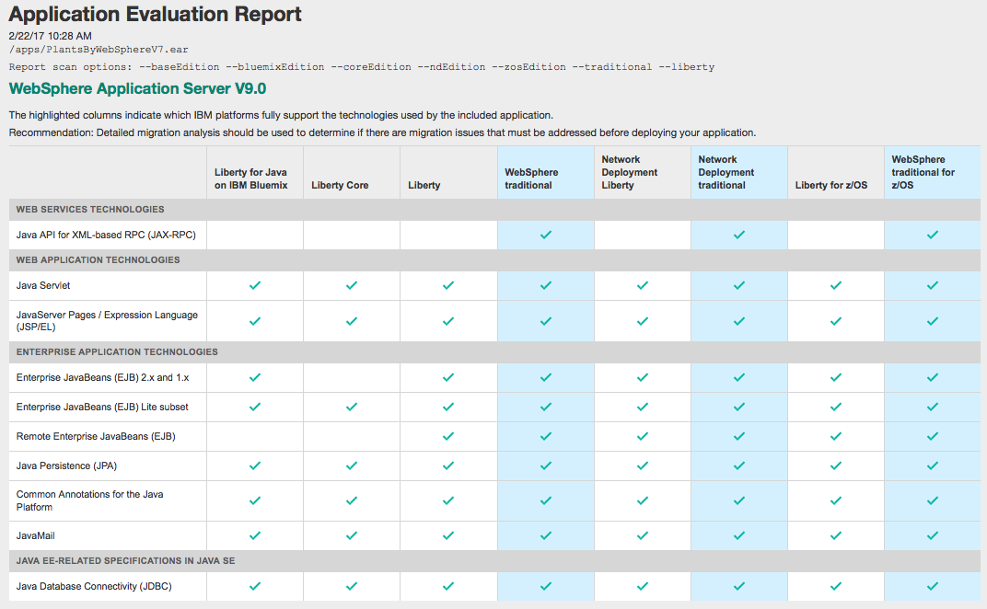
Application Evaluation Report example
Used during initial assessment and planning
Shows the Java EE technologies your application uses
Answers various questions:
Does my app use deprecated Java EE technologies?
Will my app run on Liberty for Java on Bluemix?
Should I continue using traditional WebSphere?

Slide 26
How do I use the configuration migration tools?
traditional WebSphere
traditional WebSphere (profile)
Migration wizard
traditional WebSphere
WebSphere Configuration Migration Tool
WebSphere Liberty (server.xml)
JBoss
traditional WebSphere (scripts)
WebLogic
WebSphere Application Migration Toolkit
Tomcat
WebSphere Liberty (server.xml)

Slide 27

Migration wizard (WASPreUpgrade/WASPostUpgrade)
Full Profile Migration
Two step process
WASPreUpgrade: Configuration data from source profile is captured into a migration backup directory
WASPostUpgrade: Source data is merged into the new target profile
You can keep the old system running until the new environment is ready to be used
Various strategies and options are available for running a migration
Standard Migration Strategy (copy and replace)
Clone Migration Strategy (copy and coexist)
Notes:
Configuration migration is a two step process. Profile data from the old version or source profile is captured into a migration backup directory. Later the source data is merged into the new target profile.
This two step process allows you to keep your old system running until the new environment is ready. There are various options for running a migration, depending on the topology of the installation. These scenarios are outlined in the WebSphere Application Server information center and white papers.
When using the migration command line tools, it is the responsibility of the user to create the appropriate target profile in the V9.0 release. The migration wizard will automatically detect and create the correct target profile type.
Topologies include:
Stand Alone Servers
Cell Environment - A Deployment Manager and one or more Federated Nodes.
Flexible Managed Environments – A Job Manager or Admin Agents with Registered Servers.
Migration of any Flexible Management profile has certain restrictions with mixed cell environments.

Slide 28

WCMT: Configuration scanning
traditional WebSphere Application Server V7+
JBoss
WebSphere Liberty
WebSphere Configuration Migration Tool
Oracle Application Server
traditional WebSphere Application Server
WebLogic
Tomcat
WebSphere Liberty
Notes:
The WebSphere Configuration Migration Toolkit (WCMT) is tool that can accelerate the migration of your runtime environment to WebSphere Full profile and Liberty profile.
WCMT is an Eclipse plug-in that reads your existing server configuration from either WebSphere V7.0, V8.0, V8.5.5 Full Profile, WebLogic, or JBoss. It creates equivalent resources in WebSphere V8.5.5 Liberty profile server.xml or creates a Jython script that creates equivalent resources in WebSphere V8.5.5 Full profile.
Helps you move server configuration and application configuration to Liberty by automatically migrating portions of the configuration
Helps migrating resource configuration from traditional WebSphere Application Server to Liberty
When migrating to traditional WebSphere Application Server, the tool generates scripts to be used with the configuration
When migrating to Liberty, the tool generates the server.xml configuration
Supports the following migrations:
Migrating from Apache Tomcat 6.0 or 7.0
Migrating to Liberty V8.5.5
Migrating Apache Tomcat context, server, and web XML information contained in the server
Migrating Apache Tomcat context and web XML information contained in the application
Helps you migrate a server configuration from JBoss, Oracle Application Server, or WebLogic to traditional WebSphere Application Server or Liberty

Slide 29

I have many apps to migrate, what do they need?
WebSphere Application Migration Toolkit (WAMT)
Scans application source to provide
A high level evaluation report showing with Java EE technologies your application uses
A line-by-line analysis of code changes required with detailed information and quick fix code changes where possible
Runs in Eclipse against application source
Evaluates the Java, JSP, and XML files
Includes command-line analysis of application binaries
High level evaluation report
Detailed analysis for WebSphere Liberty and IBM Bluemix

Slide 30
WAMT: Analyzing application source code
traditional WebSphere Application Server 6.1+ application
JBoss application
WebSphere Application Migration Toolkit
WebSphere Liberty application
WebLogic application
traditional WebSphere Application Server application
Tomcat application
Java EE 6 or 7
Java SE 7 or 8
On premises, instant runtime, WAS on Cloud, Docker
Oracle Application Server application
Notes:
WAMT can be used for traditional Version to Version migrations, and also for migrating apps from competing app servers. It can also be used to migrate applications to liberty as the target server, or to other cloud foundry platforms. In addition to the WebSphere Application server for liberty, there are specific rules for migrating applications to Liberty on Bluemix.

Slide 31
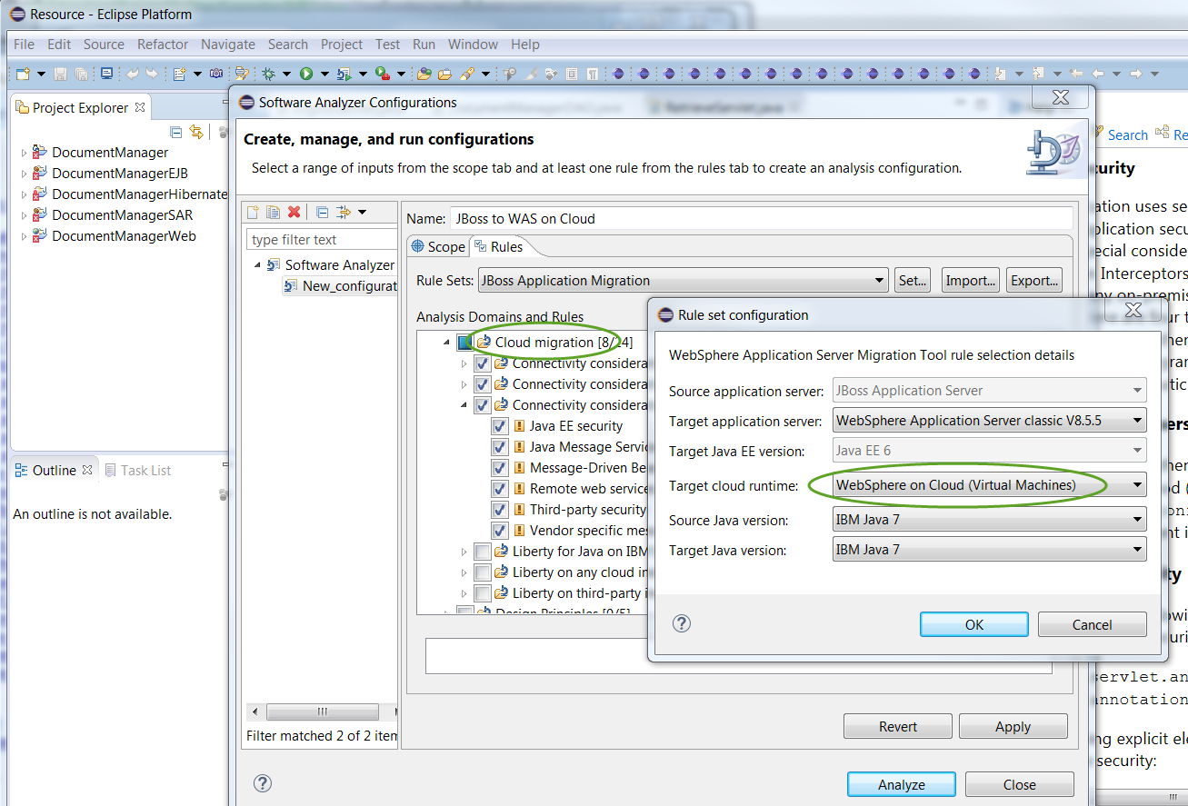
WAMT: Details on how to update the source code
Configure analysis rules appropriate for your source and target Java EE server and cloud platform
Choose your Java SE source and target
Choose your Java EE source and target
Notes:
WAMT can also produce a more detailed report, showing you every line of source that may need to change. It provides detailed information about each rule that was triggered and where possible it provides ‘quick fixes’ to make the code changes for you.

Slide 32
What can the detailed analysis detect?
WebSphere version migration
Identify issues in applications moving to newer version of WebSphere
Migrate applications from v6.1, v7.0, v8.0, v8.5.5 (source scanner goes back farther)
Migrate applications to v8.5.5, v9.0
WebSphere Liberty
Identify programming models not available in WebSphere Liberty
Behavior changes between traditional WebSphere and WebSphere Liberty
Java EE 7 and SE differences
Cloud migration
Optimize your application for IBM Bluemix and WebSphere Liberty PaaS
Instant runtimes, Docker, and WebSphere on Cloud targets
Connectivity considerations
Third-party application servers
Migrate applications from Oracle (WebLogic and Oracle AS), JBoss or Tomcat to traditional WebSphere and WebSphere Liberty

Slide 33
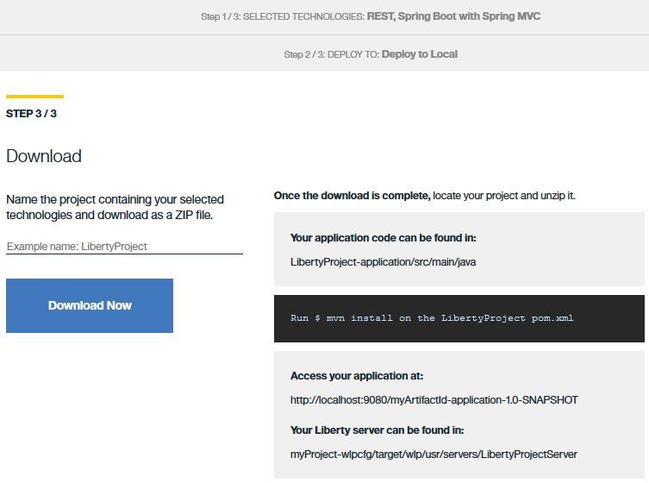
Liberty App Accelerator for Microservice creation
Get a Java-based microservice that uses WebSphere Liberty
Built and deployed in less than 10 minutes
Provides:
Configuration for your application
Code snippets for your application
Possible deployment options:
Local
Bluemix
http://wasdev.net/accelerate
Notes:
Compare to http://start.spring.io

Slide 34
Microservice Builder: Built for the enterprise journey
Single Developer
(experimentation)
A Single Team
Multiple Teams
Collaborating
Stages of
Maturity
Single Container
Single Service
Microservices
App
A
A
B
C
a
Platform Services
Technology/Ecosystem
Docker Containers
Pods , Clusters
Amalgam8
OpenTracing
(kubernetes)
Elk Stack
ISTIO
Integration
Collaboration
Innovation
Problem
Solved
Portability
Orchestration
Clustering

Slide 35
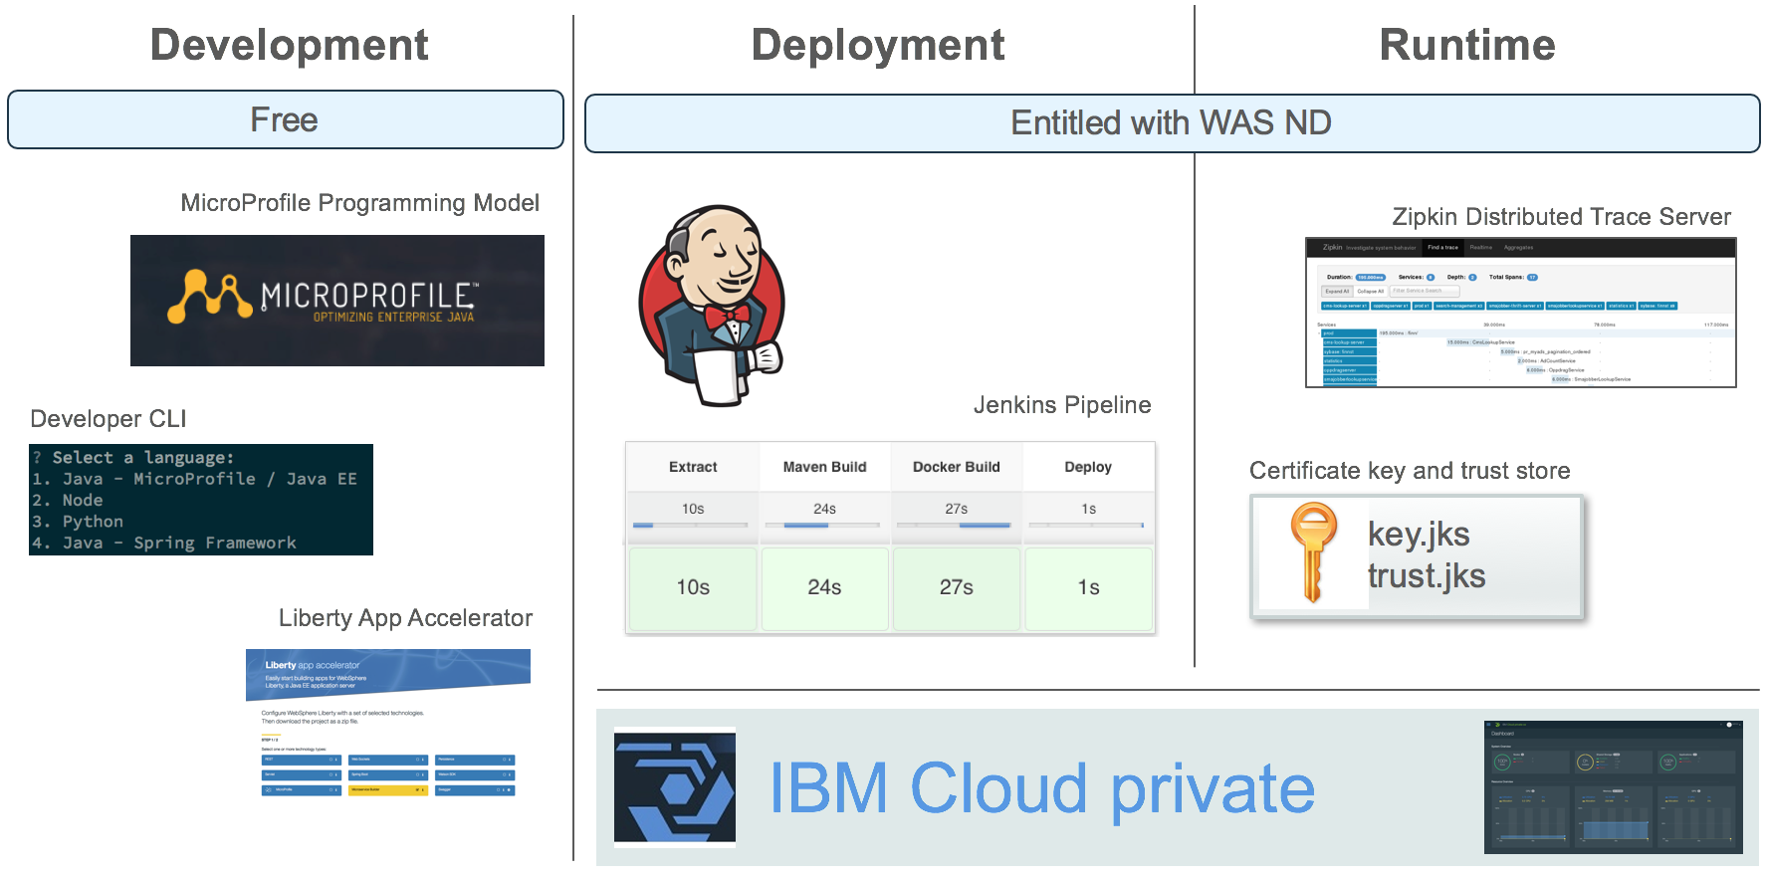
Microservice Builder: From development to production
Development
Deployment
Runtime

Slide 36
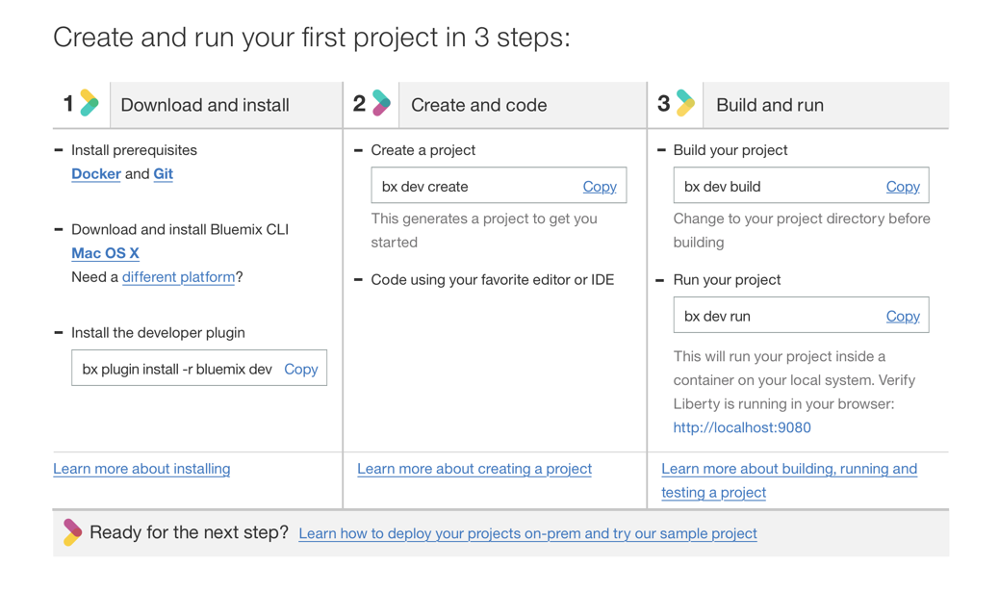
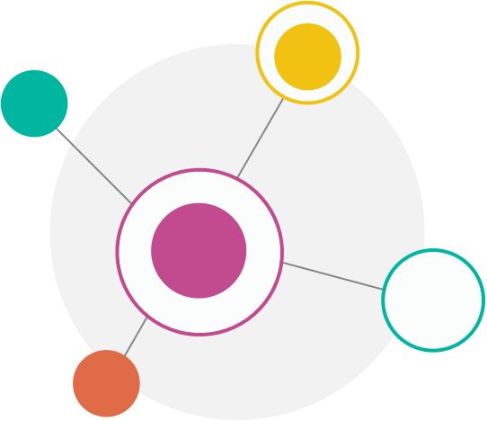
Developer CLI
Quickly create, build and run new services with minimal pre-reqs
“create” walks developer through choice of a pattern (e.g. microservice) and language (Java, Node or Swift) and generates project
“build” uses a containerized set of tools to build the application and package it in a Docker image
“run” executes the Docker image locally
CLI and Docker are the only prerequisites
36

Slide 37
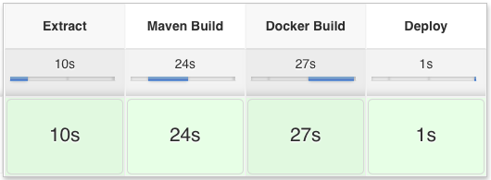

Microservice Builder pipeline
Automated build and deployment of microservices for rapid delivery
GitHub/GitHub Enterprise
Jenkins
▾ my-org
► my-org ► service-b ► master
► service-a
▾ service-b
► src
Dockerfile
Jenkinsfile
▾ manifests
deploy.yaml
pom.xml
Registry
IBM Cloud Private
Kubernetes

Slide 38
Microservice Builder fabric
Runtime components to support microservice deployments
Fabric provides shared Liberty key and trust stores to set up trust for inter-service communication
Distributed tracing enables tracking of requests as they traverse microservices for problem determination and causal analysis
Applications use Open Tracing API to delineate trace spans
Fabric provides Zipkin server for collection and visualization of spans

Slide 39
Transformation Advisor
Shikha Srivastava ssriva@us.ibm.com

Slide 40
Evolving towards a hybrid solution – example journey
Transformation Advisor
Is targeted to help customer in their journey to cloud
Leverages existing tools where applicable (for example WAMT, WCMT)
Target is traditional WebSphere (on-premises) -> WebSphere Liberty (Cloud)
1.Start with Legacy app
2 Expose API
3. Lift and Shift to private cloud
Transformation Advisor provides an end to end to experience for the Application owner, Developer, and Project Manager to:
Discover on-premises client applications
Get recommendations for migrating applications to the cloud
4. Transition some to public cloud
5. Cloud Native

Slide 41
Transformation Advisor
End-to-end experience for the Application owner, Developer, Project Manager
1
Identify what can be migrated to IBM Cloud and at the effort involved
2
Help manage the migration process from fixing code issues to dev/staging/prod deployment leveraging existing services / tools
Discover source environment:
Capture user preferences: (examples)
Wants to move to Private Cloud
Prefer not to move data
Can refactor applications if needed
Optionally provides some configuration details of target environments
Use / add best practices and constraints: (examples)
Available private cloud options: Liberty
Available public cloud options: tWAS9
Move if refactoring cost is <100 PMs
Keep applications on different source ND clusters on different target clusters
Do not put a high usage DB >1 network hop away
Provide recommendation and seen downstream actions:
Choice of target servers and platforms
Cost for moving to each target option
Notes:
Start with WebSphere based applications and use its dependencies to drive adoption of other IBM Software on IBM Cloud.

Slide 42
Transformation Advisor Rule examples
 | Category | Rule
1 | Dev (WAMT rules) | Functional code assessment of application binaries by WAMT to determine which source and target WAS editions/versions have what technical compatibility issues.
2 | Dev | Assign dev costs to each application issue / issue category detected by WAMT. Call out high cost thresholds at issue and total cost level.
3 | Dev | Which legacy WAS versions should not be considered for migration at all because they have prohibitive refactoring cost.
4 | Dev | Functional assessment to determine whether embedded messaging in ICp Liberty (or tWAS SIBus) can be used or we need full messaging solution.
5 | Performance | Determine ideal location of a DB connected to the application - in Cloud or keep where it exists depending on user pref, usage frequency, size and any other performance attributes.
6 | Performance | Max number of network hops between a DB and application depending on criticality of data access and usage frequency.
7 | Performance | Determine whether embedded messaging should be used in ICp Liberty based on usage and other performance requirements.
8 | Performance | Max number of network hops between application and messaging depending on usage frequency and latency requirements.
9 | Performance | Depending on application container dependencies and latency requirements, co-locate the containers in same network.
10 | Performance | Determine sizing of containers depending on user inputs and in future usage data.
11 | Performance | Determine number of container replicas in ICp for load balancing
12 | Availability | Determine number of container replicas in ICp for recovery.
13 | Security | Anti-Colocation constraints between containers
14 | Security | Which application containers need in / outbound access (external dependencies)
15 | Security | Determine location of the DB in Cloud or where it exists depending on data security
* each rule can have a cost implication, e.g. replicas and anti-colocation of containers can increase cost

Slide 43
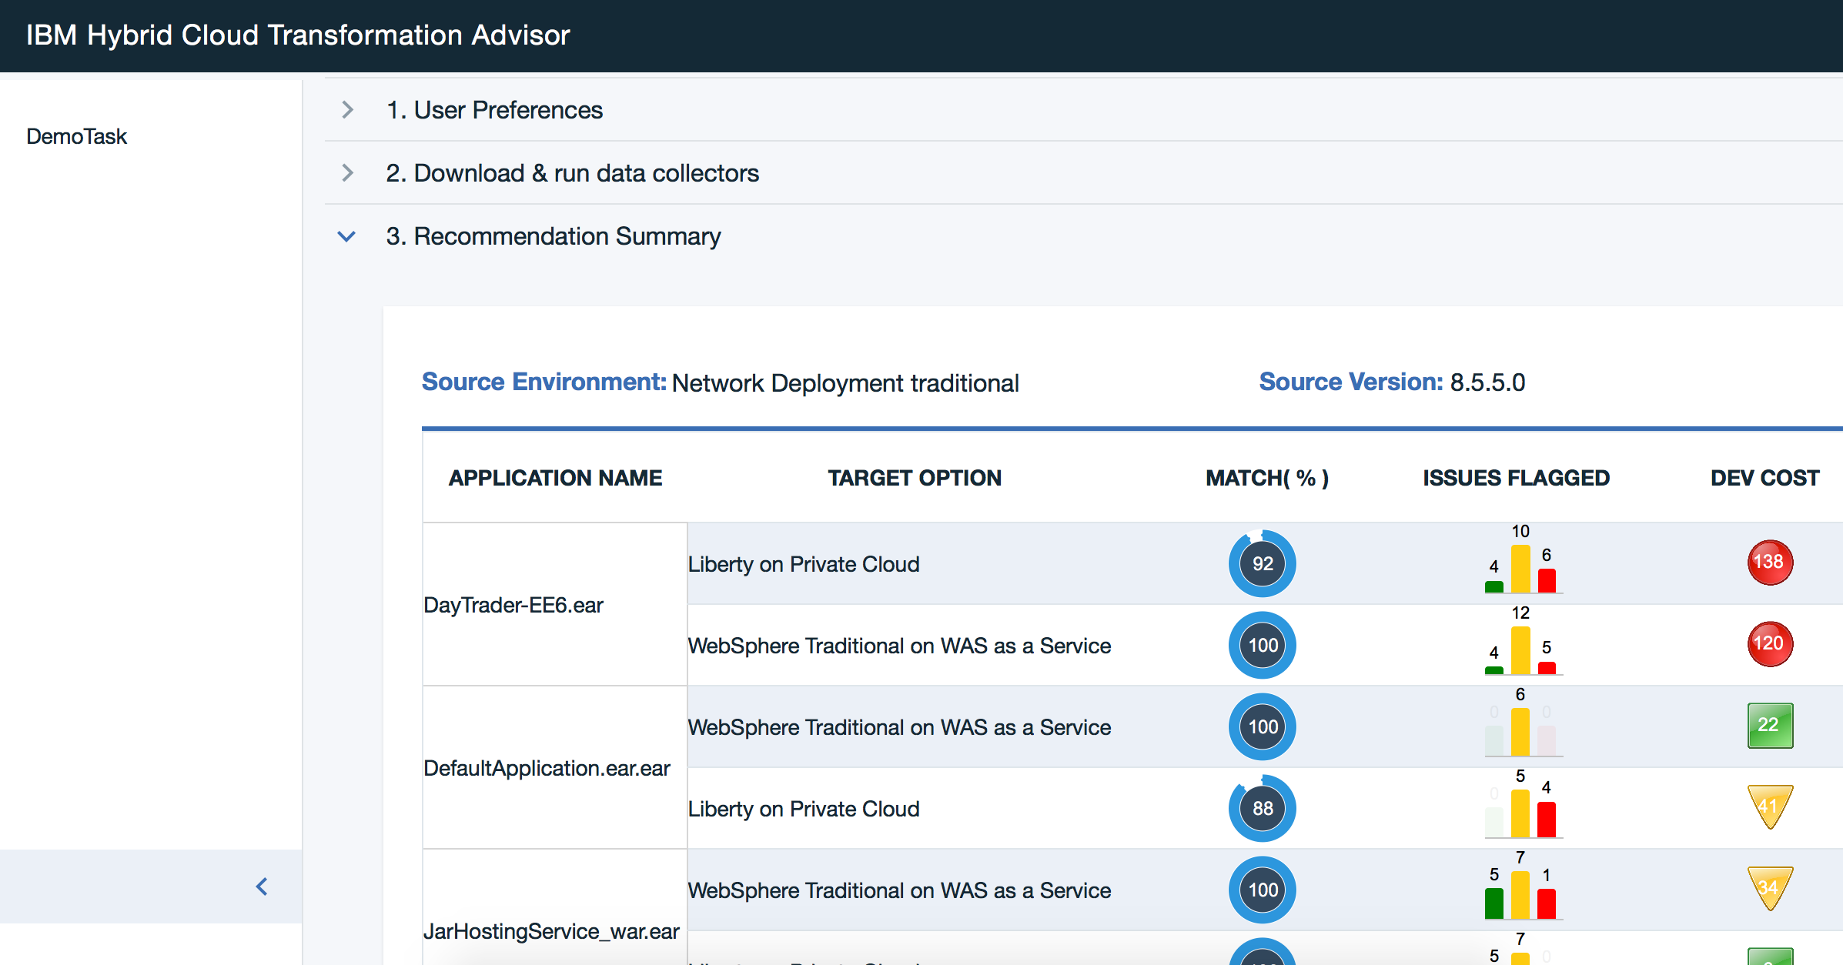
Transformation Advisor – Example output

Slide 44
WebSphere Liberty on IBM Cloud Private

Slide 45
Deploying an application to IBM Cloud Private
Deploying an application to a IBM Cloud Private environment involves the following key tasks:
Build a Docker image with the application deployed with in
Run and verify the Docker image locally
Push the Docker image into the IBM Cloud Private Docker registry
Run the Docker image in IBM Cloud Private environment
Expose the running container for external access
Verify and test the application

Slide 46
Deploying an application to IBM Cloud Private
Deploying an application to a IBM Cloud Private environment involves the following key tasks:
Build a Docker image with the application deployed with in
Run and verify the Docker image locally
Push the Docker image into the IBM Cloud Private Docker registry
Run the Docker image in IBM Cloud Private environment
Expose the running container for external access
Verify and test the application
The most important step for WebSphere-based workloads!

Slide 47
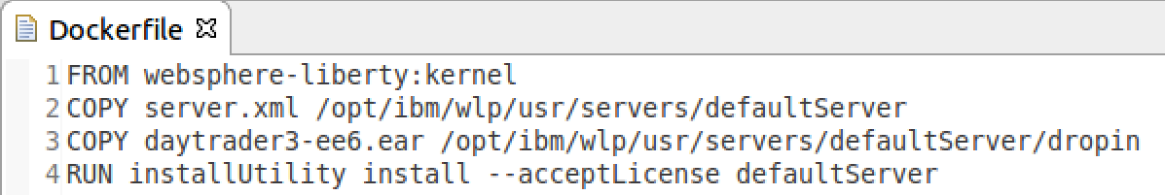
Building a Docker image for IBM Cloud Private (1 of 3)
Step 1: Create a Dockerfile
FROM: Base image for the new image. IBM has published an official set of foundational Docker images containing IBM products, such as WebSphere Liberty
Dockerfile: A text file containing Docker image building instructions
COPY: Instruction to copy a configured server.xml file to the Liberty server in the base image
COPY: Instruction to copy an application deployable to the Liberty server’s dropin folder in the base image
RUN: Execute shell commands to install all required Liberty features
COPY: You may also copy a configured Liberty server with your application deployed as a whole.
Alternate

Slide 48
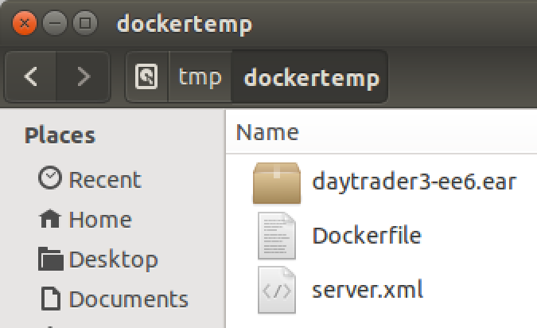
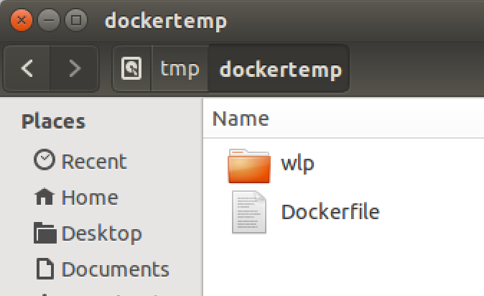
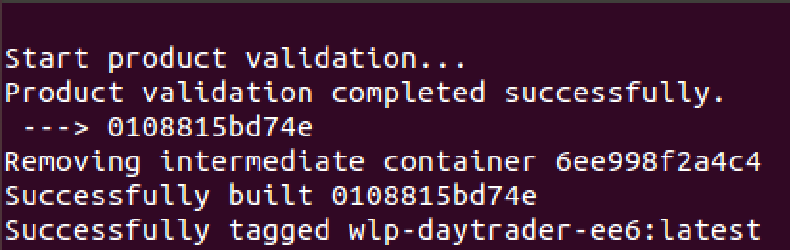
Building a Docker image for IBM Cloud Private (2 of 3)
Step 2: Prepare deployable artifacts
Copy all files required in Dockerfile into a temporary deployment directory including the Dockerfile itself. This minimized the number of files pushed to the Docker daemon.
Copy the configured Liberty server folder into the temporary deployment folder if doing the whole server push.
Alternate
Step 3: Run Docker CLI build command
docker build -t wlp-daytrader-ee6 .
Build Result
-t <tag_name>: creates a tag for your own custom image. Tags are used for versioning and registry specification.
<context_path>: root directory where all source artifacts specified in the Dockerfile are located.

Slide 49
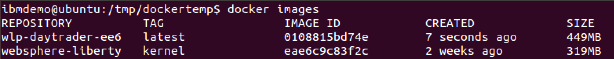
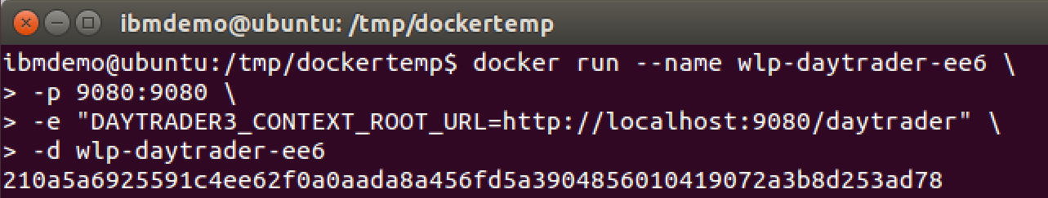
Building a Docker image for IBM Cloud Private (3 of 3)
Step 4: View Docker image(s)
docker images
Step 5: Run Docker image
docker run --name wlp-daytrader-ee6 –p 9080:9080 –d wlp-daytrader-ee6
--name: the name you wish to assign to the container.
-p: publish a container port to a host port. In this case port 9080 on the container will be available to the host using port 9080
-d: detach the container to run in the background and print the container id.
Docker image to run

Slide 50
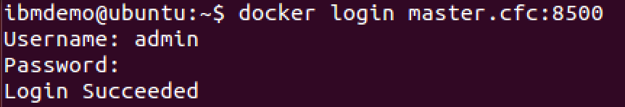
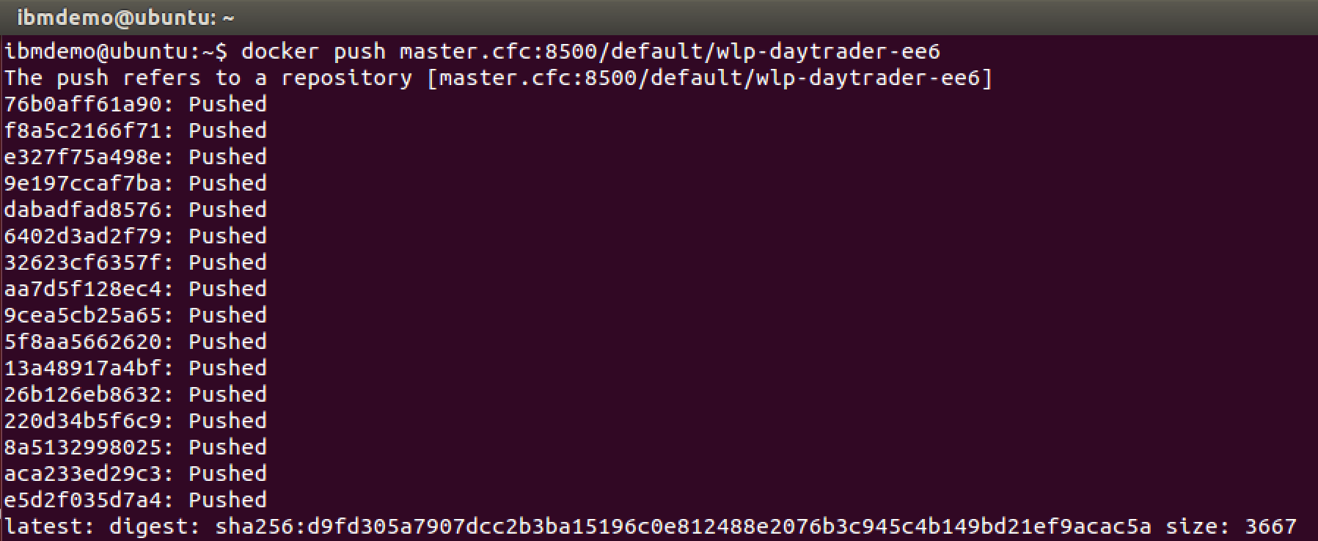
Deploying a Docker image to IBM Cloud Private (1 of 8)
Step 1: Login to IBM Cloud Private
docker login <cloud_private_host:port>
Step 2: Tag image with IBM Cloud Private Docker registry information
docker tag wlp-daytrader-ee6 <cloud_private_host:port>/default/wlp-daytrader-ee6
Step 3: Push image to IBM Cloud Private Docker registry
docker push <cloud_private_host:port>/default/wlp-daytrader-ee6

Slide 51
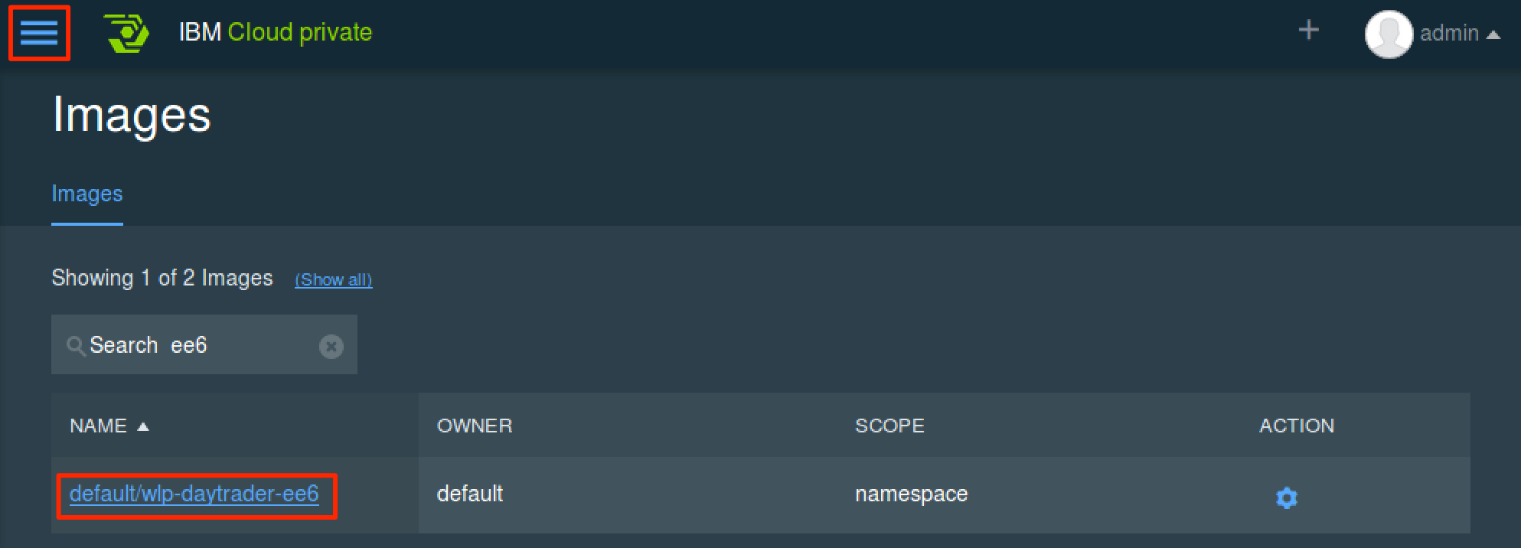
Deploying a Docker image to IBM Cloud Private (2 of 8)
Step 4: Verify image push in IBM Cloud Private dashboard
Go to Menu → Infrastructure → Images

Slide 52
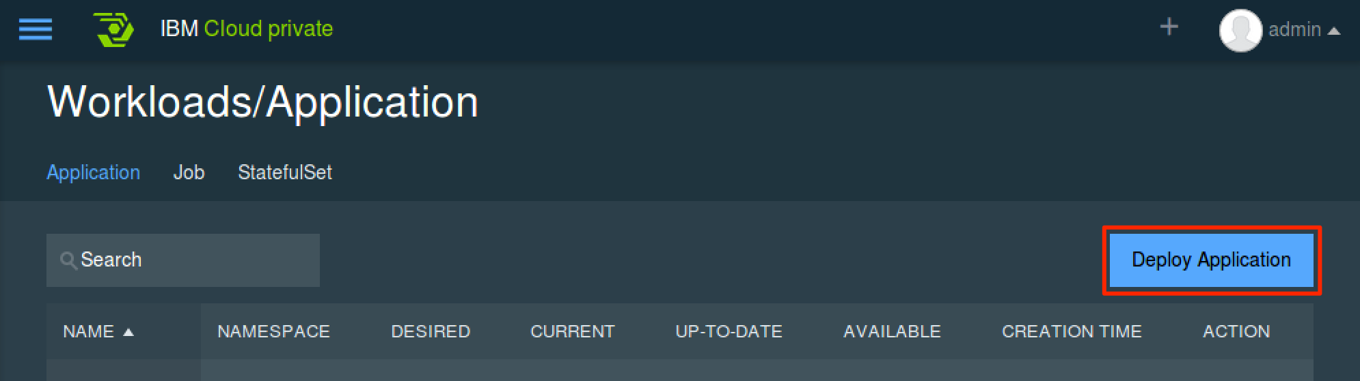
Deploying a Docker image to IBM Cloud Private (3 of 8)
Step 5: Initiate application deployment
Go to Menu → Workloads → Applications
Click Deploy Application to initiate application deployment

Slide 53
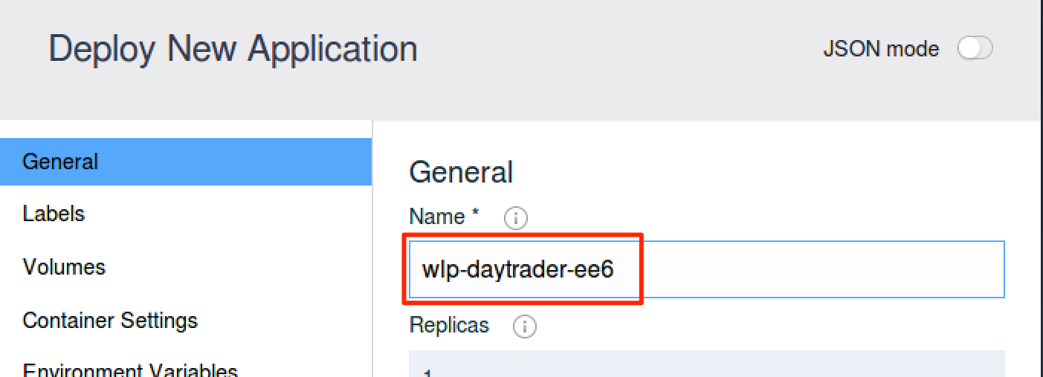
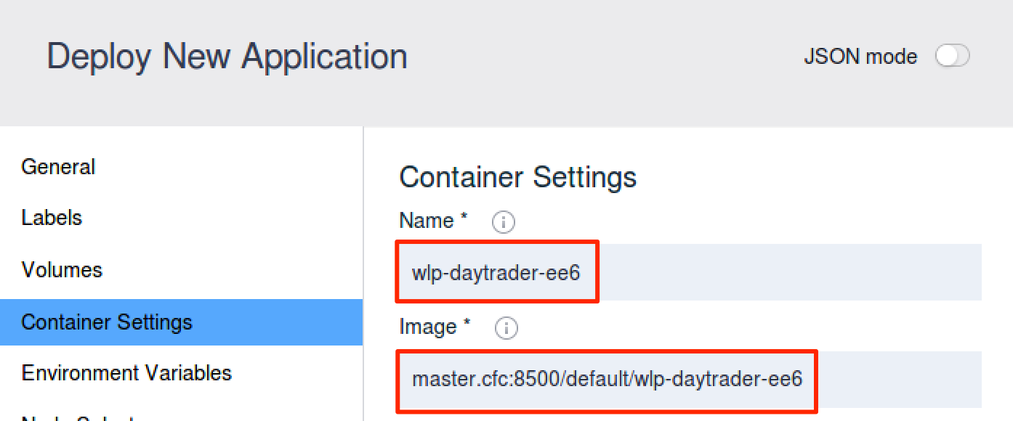
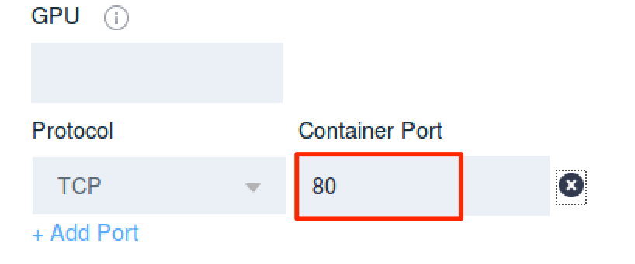
Deploying a Docker image to IBM Cloud Private (4 of 8)
Step 6: Enter application deployment information
Tab: General
Field:
Name – name of the application
Tab: Container Settings
Fields:
Name – name of the container
Image – name of the image (must match image tag name)
Protocol & Container Port – Liberty server port to be exposed by the container

Slide 54
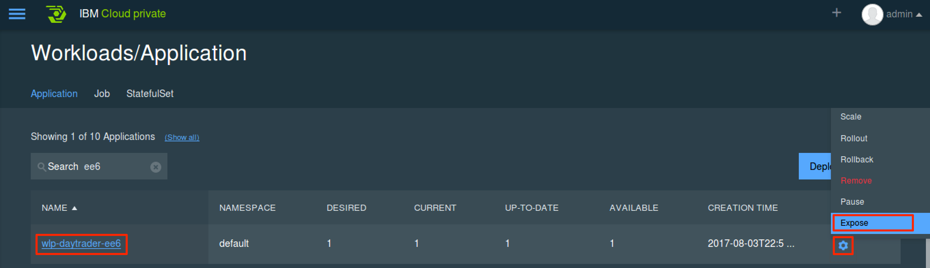
Deploying a Docker image to IBM Cloud Private (5 of 8)
Step 7: Expose deployed application for external access
Go to Menu → Workloads → Applications
Click to Settings → Expose to create a service to expose application for external access

Slide 55
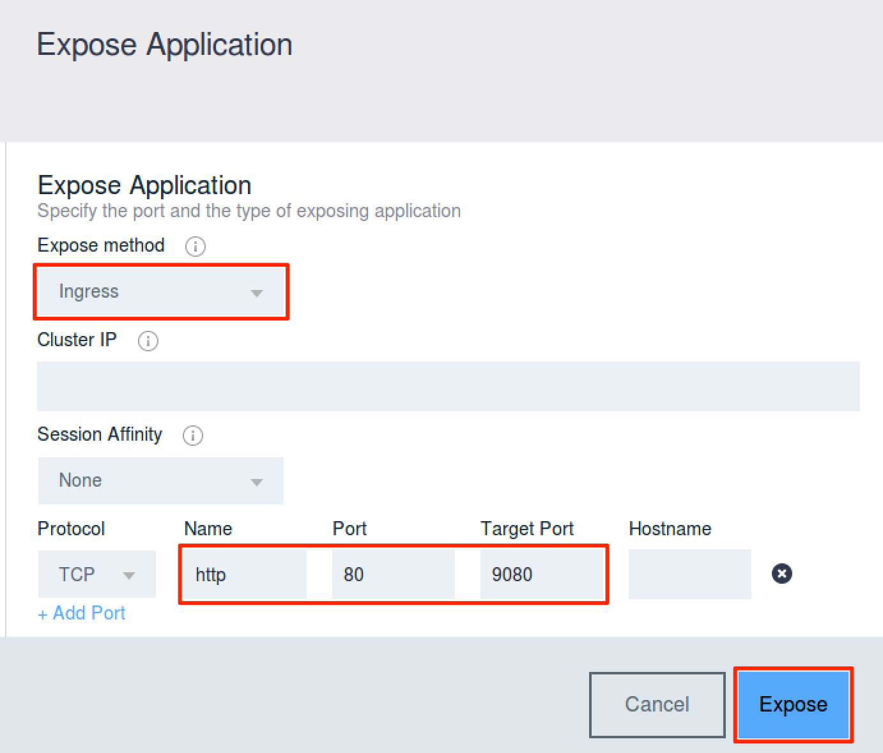
Deploying a Docker image to IBM Cloud Private (6 of 8)
Step 8: Enter expose service information
Expose method:
ClusterIP – Exposes the service on a cluster-internal IP. Service only reachable from within the cluster. (default).
NodePort – Exposes the service on each Node’s IP at a static port (the NodePort). You’ll be able to contact the NodePort service, from outside the cluster, by requesting <NodeIP>:<NodePort>.
Ingress – Exposes the service on IP and PORT assigned based on default ingress controller configured for the environment.
Protocol, Name, Port, & Target Port: Source and target port on the container to be exposed.
Click Expose to create a service to expose the application.

Slide 56
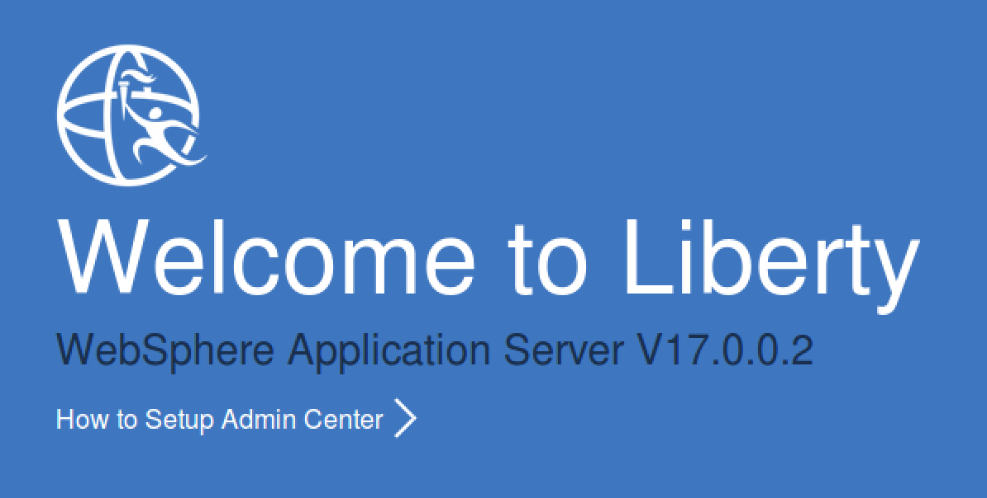
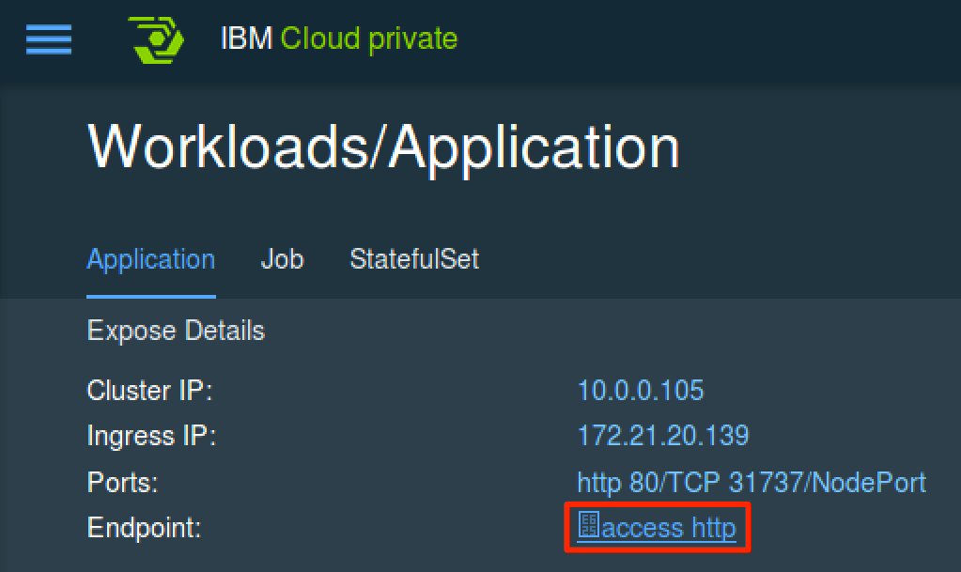
Deploying a Docker image to IBM Cloud Private (7 of 8)
Step 9: Verify application accessibility
Go to Menu → Workloads → Applications and click the application from the list
Click the access http link to open the Liberty server root context. Append application specific context path to access deployed application.

Slide 57
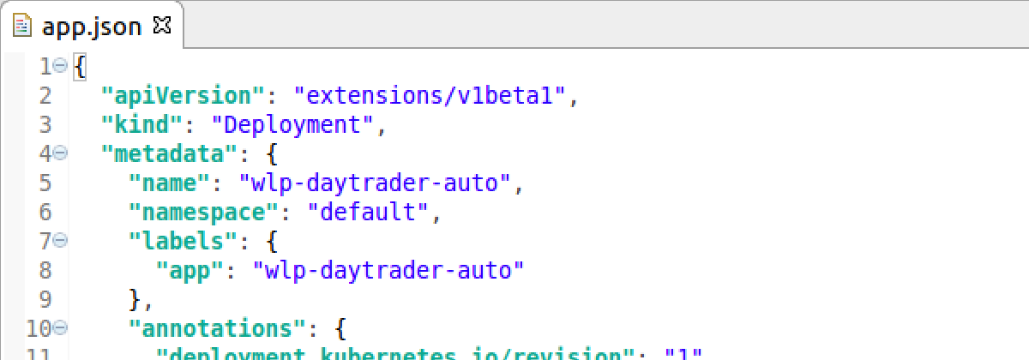
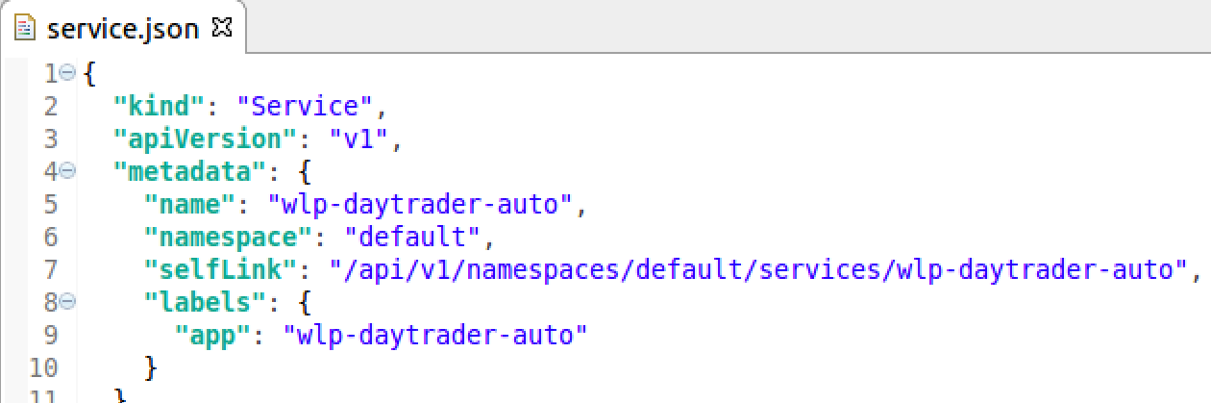
Deploying a Docker image to IBM Cloud Private (8 of 8)
Alternate Step: Deploy application using kubectl CLI
kubectl create -f app.json
The Kubernetes command line interface (CLI) provides extensive deployment and management options
The CLI deployment and management option supports scripting and automation
Alternate Step: Expose application using kubectl CLI
kubectl create -f service.json

Slide 58
Backup

Slide 59
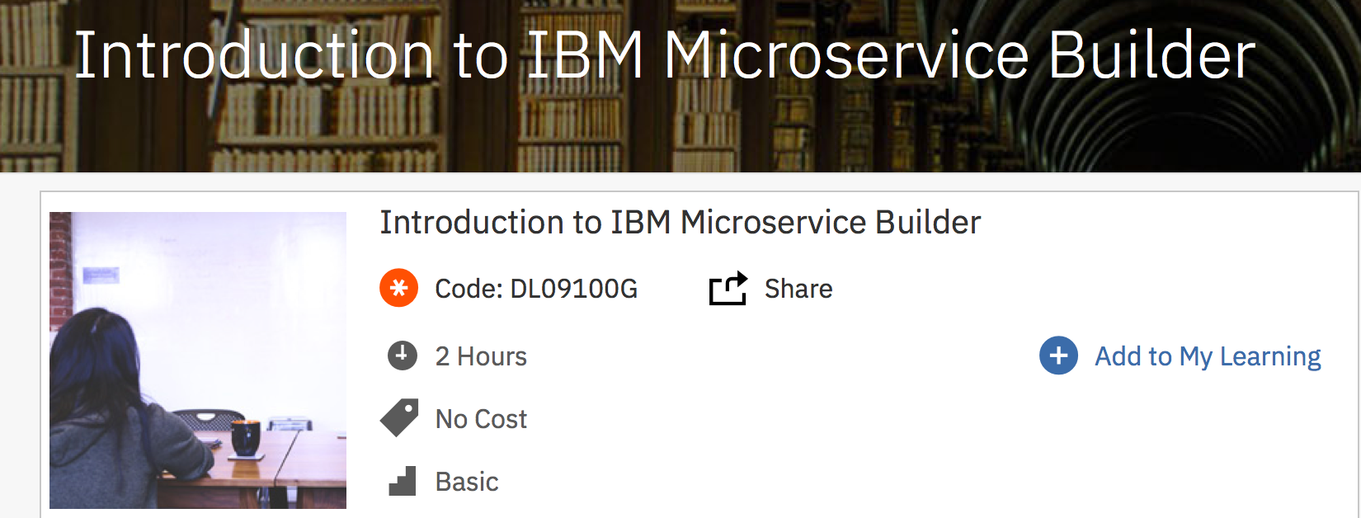
Education – Introduction to IBM Microservice Builder
https://www-03.ibm.com/services/learning/ites.wss/zz-en?pageType=course_description&cc=&courseCode=DL09100G&gtpcc=us

Slide 60
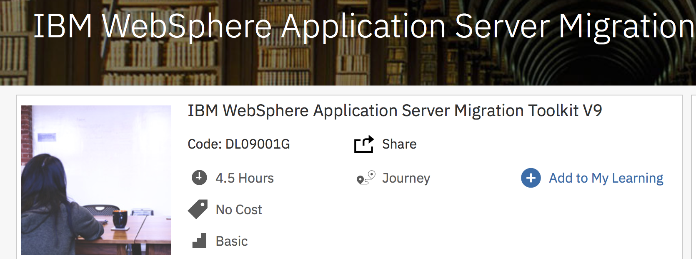
Education – IBM WebSphere Application Server Migration Toolkit V9
https://www-03.ibm.com/services/learning/ites.wss/zz-en?pageType=course_description&cc=&courseCode=DL09001G&gtpcc=us

Slide 61
Microservice Builder and IBM Cloud Private resources
Helpful Links
Microservice Builder Webcast June 2017: https://www.imwuc.org/p/do/sd/sid=3509 Microservice Builder Developer Center: https://developer.ibm.com/microservice-builder/ IBM Cloud Private Wiki: https://www.ibm.com/developerworks/community/wikis/home?lang=en#!/wiki/W1559b1be149d_43b0_881e_9783f38faaff
Knowledge Center: http://ibm.biz/microservicebuilderdoc https://www.ibm.com/support/knowledgecenter/SSBS6K/product_welcome_cloud_private.html
Marketplace: https://www.ibm.com/us-en/marketplace/microservice-builder

Slide 62
IBM Cloud Private resources
Helpful Links
IBM Cloud Private blog post: https://t.co/ST1FKnkaTM Video on IBM Cloud Private: https://t.co/KC4H3pSuLL
Build and continuously deliver a Java microservices application in IBM Cloud Private: https://ibm.co/2vGNtZI Developing microservices for IBM Cloud Private: https://ibm.co/2vGNtZI

Slide 63
Hybrid Cloud CTO developerWorks recipes
Helpful Links
Use Kubernetes Secrets to Make Your App Portal Across Clouds: https://developer.ibm.com/recipes/tutorials/use-kubernetes-secrets-to-make-your-app-portable-across-clouds/ Running Istio on IBM Cloud Private: https://developer.ibm.com/recipes/tutorials/running-istio-on-ibm-cloud-private Deploy MQ into IBM Cloud Private: https://developer.ibm.com/recipes/tutorials/deploy-mq-into-ibm-cloud-private
Deploy Db2 into IBM Cloud Private: https://developer.ibm.com/recipes/tutorials/deploy-db2-into-ibm-cloud-private

Slide 64
Backup

Slide 65




WebSphere supports the entire hybrid cloud landscape
WebSphere traditional
Speed of Operation
Manage & maintain stable, mission critical transactional applications
Systems of Record
WebSphere Liberty
Speed of Innovation
Explore, develop and deploy for growth opportunities
Systems of Engagement, DevOps, Continuous Delivery, Microservices, Cloud
Plus
Composable
Continuous delivery
Continuous integration
Autonomic scaling
Continuous monitoring
Longer release cycles
Cost savings with workload consolidation
Enterprise Apps
Cloud
IoT
Servers
WebSphere Application Server
Enterprise Assets
Marathoner
Mobile
Data
24 x7 availability
Rock solid security
Deployment flexibility
Sprinter
IT-centric user requirements
Longer life cycles
Contextual contents
Zero migration
Cloud and Mobile friendly security
Notes:
Our solution is WebSphere Liberty, introduced as part of WebSphere V8.5 in 2012 and part of every WebSphere offering since then. WebSphere Liberty provides a lightweight, composable runtime that maintains application-level runtime compatibility with traditional WebSphere, but has a development and operational experience geared towards rapid development and cloud deployment. Crucially, we did not create a separate offering and did not make customers think about deployment choices before they made a purchasing decision. This has allowed them to adopt WebSphere Liberty successfully at the own pace and enabled WebSphere as a whole to remain successful through an overall industry transformation to cloud.

Slide 66
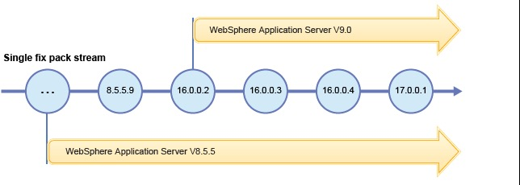
WebSphere Liberty continuous delivery
WebSphere V9 introduces a new 9.0.0.0 service stream for traditional WebSphere fixpacks
WebSphere Liberty follows a continuous delivery model with a single service stream
It makes no sense to persist with a major version for Liberty fixpacks in a ‘versionless’ single delivery stream.
To properly reflect this the WebSphere Liberty fixpack numbering is:
Y.R.M.F: year.release.modlevel.fixpack
For example, 16.0.0.4 would be the fourth fix pack in 2016
It is just a number - there is no migration required at all to the first V9 release of WebSphere Liberty: 16.0.0.2.
Notes:
So the first V9 delivery of WebSphere Liberty is the same as the next v8.5.5 fixpack – that is what single service stream means.
It would make no sense to have identical 9.0.0.0 and 8.5.5.10 deliveries so we are emphasizing the versionless delivery stream by using a numbering scheme based on year and fixpack number. The first V9 delivery of WebSphere Liberty is the second fixpack of 2016 and is numbered 16.0.0.2.

Slide 67
Benefits of microservices
Microservices are:
Decomposed into small pieces
Easier to scale development
Each service can be developed and deployed independently
Eliminates any long-term commitment to a technology stack
Focus on fine-grained units of work and coordination logic is omitted
Refactoring
Adds microservices to an application without changing the purpose of the application
Modernizes the application and gains resources provided by new structures and platforms
Smaller, faster, and stronger
Loosely coupled

Slide 68
Java workload transformation steps
Step 1: Migrate to a newer version of WebSphere
Migrate to the latest version, traditional WebSphere V9 or WebSphere Liberty
Step 2: Migrate the monolith to a cloud-ready runtime (think WebSphere Liberty)
Many Java workloads are running on old, outdated (and often out of service) runtimes
Start slowly, extending your monolith by building new features as microservices around it
Step 3: Migrate the monolith to the cloud
Application changes may be required to run in a cloud environment
Step 4: Refactor the microservices

